Slide 1
CT4029 Principles of Programming Day 2 – Session 4 Graphical User Interfaces

Slide 2
Learning Outcomes
Working with Widgets
Developing Interactive interfaces
Event Handling

Slide 3
Today’s Agenda!
Introduction to Graphical User Interface (GUI)
Introduction to Tkinter
GUI programming basics
Windows and widgets
Geometry managers
Command handlers
Callbacks
Buttons, Labels and Sliders

Slide 4
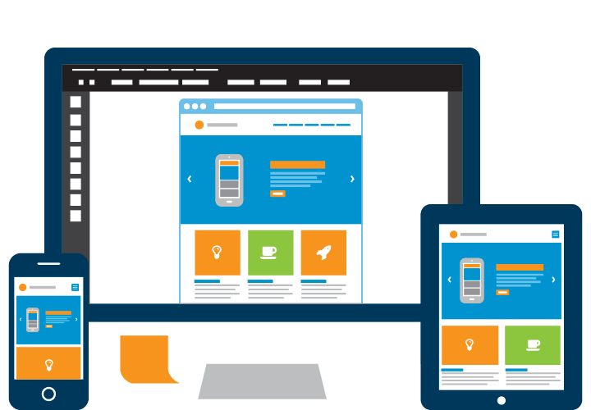
Introduction to Graphical User Interface (GUI)

Slide 5
Introduction to GUI (1/2)
In this lecture, we will cover graphical user interface (GUI) programming.
We cannot cover all the aspects of GUI programming in one session but we will set a solid foundation.
The primary GUI toolkit we will be using is Tk, Python’s default GUI. We’ll access Tk from its Python interface called Tkinter
Tk is not the latest and greatest, nor does it have the most robust set of GUI building blocks, but it is fairly simple to use, and with it, you can build GUIs that run on most platforms.
Once you have completed this lecture, you will have the skills to build more complex applications and/or move to a more advanced toolkit.

Slide 6
Introduction to GUI (2/2)
For the assignment you are free to discover more GUI tools available in Python libraries:
PyQt5
PySide2
Kivy

Slide 7
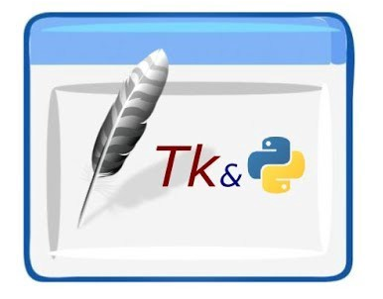
Introduction to Tkinter

Slide 8
What Are Tcl, Tk, and Tkinter?
Tkinter is Python’s default GUI library. It is based on the Tk toolkit, originally designed for the Tool Command Language (Tcl). Due to Tk’s popularity, it has been ported to a variety of other scripting languages, including Perl (Perl/Tk), Ruby (Ruby/Tk), and Python (Tkinter).
The combination of Tk’s GUI development portability and flexibility along with the simplicity of a scripting language integrated with the power of systems language gives you the tools to rapidly design and implement a wide variety of commercial-quality GUI applications.
Python, along with Tkinter, provides a fast and exciting way to build useful applications
Once you have designed the application and the look and feel that goes along with your program, you will use basic building blocks known as widgets to piece together the desired operations.

Slide 9
Getting Tkinter Installed and Working
Tkinter is not necessarily imported by default on your system. You can determine whether Tkinter is available for your Python interpreter by attempting to import the Tkinter module (in Python 1 and 2; renamed to tkinter in Python 3). If Tkinter is available, then no errors occur, as demonstrated in the following:
>>> import tkinter
>>>
If your Python interpreter was not compiled with tkinter enabled, the module import fails. You might need to recompile your Python interpreter to gain access to tkinter. This usually involves editing the Modules/Setup file and then enabling all the correct settings to compile your Python interpreter with hooks to tkinter, or choosing to have Tk installed on your system.

Slide 10
The Tkinter Module: Adding Tk to your Applications
Do you need to do to have Tkinter as part of your application?
First, it is not necessary to have an application already. You can create a pure GUI if you want, but it probably isn’t too useful without some underlying software that does something interesting.
There are basically five main steps that are required to get your GUI up and running:
Import the tkinter module (or from tkinter import *).
Create a top-level windowing object that contains your entire GUI application.
Build all your GUI components (and functionality) on top (or within) of your top-level windowing object.
Connect these GUI components to the underlying application code.
Enter the main event loop.

Slide 11
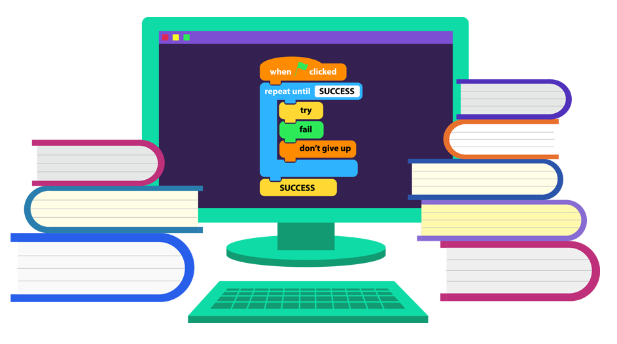
GUI Programming Basics

Slide 12
Introduction to GUI Programming
Before going to the examples, we will give you a brief introduction to GUI application development. This will provide you with some of the general background you need to move forward.
Setting up a GUI application is similar to how an artist produces a painting. Conventionally, there is a single canvas onto which the artist must put all the work. Here’s how it works: you start with a clean slate, a “top-level” windowing object on which you build the rest of your components.
Think of it as a foundation to a house or the easel for an artist. In other words, you have to pour the concrete or set up your easel before putting together the actual structure or canvas on top of it. In Tkinter, this foundation is known as the top-level window object.

Slide 13
Windows and Widgets (1/2)
In GUI programming, a top-level root windowing object contains all of the little windowing objects that will be part of your complete GUI application. These can be text labels, buttons, list boxes, etc. These individual little GUI components are known as widgets.
So when we say create a top-level window, we just mean that you need a place where you put all your widgets. In Python, this would typically look like this line:
top = tkinter.Tk() # or just Tk() with "from tkinter import *"
The object returned by tkinter.Tk() is usually referred to as the root window; hence, the reason why some applications use root rather than top to indicate as such. Top-level windows are those that show up stand-alone as part of your application. You can have more than one top-level window for your GUI, but only one of them should be your root window.

Slide 14
Windows and Widgets (2/2)
You can choose to completely design all your widgets first, and then add the real functionality, or do a little of this and a little of that along the way.
Widgets can be stand-alone or be containers. If a widget contains other widgets, it is considered the parent of those widgets. Accordingly, if a widget is contained in another widget, it’s considered a child of the parent, the parent being the next immediate enclosing container widget.
Usually, widgets have some associated behaviors, such as when a button is pressed, or text is filled into a text field. These types of user behaviors are called events, and the GUI’s response to such events are known as callbacks.

Slide 15
Event-Driven Processing (1/2)
Events can include the actual button press (and release), mouse movement, hitting the Return or Enter key, etc. The entire system of events that occurs from the beginning until the end of a GUI application is what drives it. This is known as event-driven processing.
One example of an event with a callback is a simple mouse move. Suppose that the mouse pointer is sitting somewhere on top of your GUI application. If you move the mouse to another part of your application, something has to cause the movement of the mouse to be replicated by the cursor on your screen so that it looks as if it is moving according to the motion of your hand. These are mouse move events that the system must process portray your cursor moving across the window. When you release the mouse, there are no more events to process, so everything just remains idle on the screen again.

Slide 16
Event-Driven Processing (2/2)
The event-driven processing nature of GUIs fits right in with client/server architecture.
When you start a GUI application, it must perform some setup procedures to prepare for the core execution, just as how a network server must allocate a socket and bind it to a local address.
The GUI application must establish all the GUI components, then draw (a.k.a. render or paint) them to the screen. This is the responsibility of the geometry manager (more about this in a moment). When the geometry manager has completed arranging all of the widgets, including the top-level window, GUI applications enter their server-like infinite loop.
This loop runs forever waiting for GUI events, processing them, and then going to wait for more events to process.

Slide 17
Geometry Managers
Tk has three geometry managers that help with positioning your widget set:
Placer: You provide the size of the widgets and locations to place them; the manager then places them for you. The problem is that you have to do this with all the widgets, burdening the developer with coding that should otherwise take place automatically.
Packer: it packs widgets into the correct places (namely the containing parent widgets, based on your instruction), and for every succeeding widget, it looks for any remaining “real estate” into which to pack the next one. The process is similar to how you would pack elements into a suitcase when traveling.
Grid: It is used to specify GUI widget placement, based on grid coordinates. The Grid will render each object in the GUI in their grid position.
We will stick with the Packer in this session, however feel free to have a look on how to use Placer and Grid.

Slide 18
Packer
Once the Packer has determined the sizes and alignments of all your widgets, it will then place them on the screen for you.
When all the widgets are in place, we instruct the application to enter the aforementioned infinite main loop. In Tkinter, the code that does this is:
tkinter.mainloop()
This is normally the last piece of sequential code your program runs.
When the main loop is entered, the GUI takes over execution from there.
All other actions are handled via callbacks, even exiting your application. When you select the File menu and then click the Exit menu option or close the window directly, a callback must be invoked to end your GUI application.

Slide 19
Top-Level Window: tkinter.Tk()
We mentioned earlier that all main widgets are built on the top-level window object. This object is created by the Tk class in Tkinter and is instantiated as follows:
Within this window, you place individual widgets or multiple-component pieces together to form your GUI.
>>> import tkinter
>>> top = tkinter.Tk()

Slide 20


Hello World
options
from tkinter import Label
widget = Label(None, text='Hello World') widget.pack()
# get a widget # make a Label
# arrange it in its parent
widget.mainloop()
# start the event loop
parent widget
Load a widget class from tkinter
Make an instance of it (repeat 1 and 2 as needed)
Arrange the widget in its parent widget
Enter the event loop
from tkinter import Label

Slide 21
Event Handling
Event sources (widgets) can specify their handlers
command handlers
callbacks

Slide 22


Command Handlers
use the 'command=' keyword followed by the command you want to execute
Example:
from tkinter import *
root = Tk()
Button (root, text='Press Me', command=root.quit).pack(side=LEFT) root.mainloop()

Slide 23

Callbacks
A callback is the name of the function that is to be run in response of an event
Callbacks can be defined as a free standing function in our program or as a class member.
Example:
from tkinter import *
def quit():
print (“Hello, getting out of here') import sys; sys.exit()
widget = Button(None, text='Press me to quit' , command=quit) widget.pack()
widget.mainloop()

Slide 24
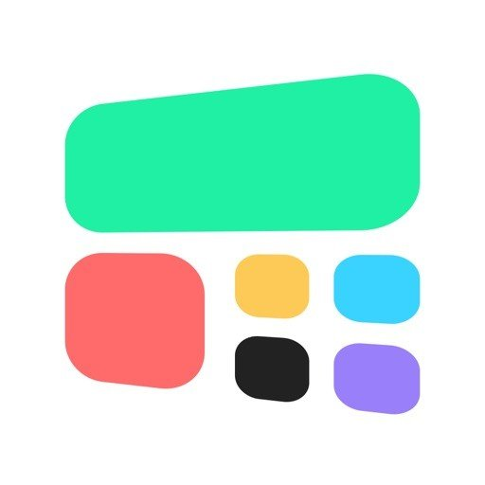
Tkinter Widgets

Slide 25
Tk Widgets
Widget | Description
Button | Similar to a Label but provides additional functionality for mouse-overs, presses, and releases, as well as keyboard activity/events
Canvas | Provides ability to draw shapes (lines, ovals, polygons, rectangles); can contain images or bitmaps
Checkbutton | Set of boxes, of which any number can be “checked”
Entry | Single-line text field with which to collect keyboard input
Frame | Pure container for other widgets
Label | Used to contain text or images
LabelFrame | Combo of a label and a frame but with extra label attributes
Listbox | Presents the user with a list of choices from which to choose
Menu | Actual list of choices “hanging” from a Menubutton from which the user can choose
Menubutton | Provides infrastructure to contain menus (pulldown, cascading, etc.)
Message | Similar to a Label, but displays multiline text
PanedWindow | A container widget with which you can control other widgets placed within it
Radiobutton | Set of buttons, of which only one can be “pressed”
Scale | Linear “slider” widget providing an exact value at current setting; with defined starting and ending values
Scrollbar | Provides scrolling functionality to supporting widgets, for example, Text, Canvas, Listbox, and Entry
Spinbox | Combination of an entry with a button letting you adjust its value
Text | Multiline text field with which to collect (or display) text from user
Toplevel | Similar to a Frame, but provides a separate window container

Slide 26
Button
Button(master=None, **options) (class) [#] A command button.
Master: Parent widget
**options: Widget options
See the description of the config method for a list of available options.
Buttons can contain text or images, and you can associate a Python function or method with each button. When the button is pressed, Tkinter automatically calls that function or method.
The button can only display text in a single font, but the text may span more than one line. In addition, one of the characters can be underlined, for example to mark a keyboard shortcut. By default, the Tab key can be used to move to a button widget.

Slide 27

Button Widget Demo
import tkinter
top = tkinter.Tk()
quit = tkinter.Button(top, text='Hello World!', command=top.quit)
quit.pack() tkinter.mainloop()

Slide 28
Label
Label(master=None, **options) (class) [#] Display a single line of text, or an image.
master Parent widget.
**options Widget options.
See the description of the config method for a list of available options.
Label is used to display a text or image on the screen. The label can only display text in a single font, but the text may span more than one line.
Can be used as a label for another widget (like an Entry Widget) or as an output only widget on the screen.
associate a text variable with the label and whenever the text variable changes value the label field will change. Use the set() method to update the Text variable (or get() to retrieve is current value).
text may be anchored N, NE, E, SE, S, SW, W, NW, or CENTER. Default is CENTER

Slide 29

Label Widget Demo
from tkinter import * import tkinter as tk top = tk.Tk() label = tk.Label(top, text='Hello World') label.pack() tk.mainloop()

Slide 30

Widget Configuration
Configuration can be specified at creation time or changed as the program is running by using the config method
Example:
import tkinter
top = tkinter.Tk()
w = tkinter.Label(top, text="Hello, world!")
w.pack()
w.config(text="Hello Q!")
tkinter.mainloop()

Slide 31

Updating the text variable
import tkinter as tk from tkinter import * root = Tk() # To create a Tkinter variable, call the corresponding constructor v = StringVar() label = tk.Label(root, textvariable = v).pack() v.set("New Text!") print (v.get()) root.mainloop()

Slide 32

Label and Button Widget Demo
import tkinter
top = tkinter.Tk()
hello = tkinter.Label(top, text='Hello World!')
hello.pack()
quit = tkinter.Button(top, text='QUIT', command=top.quit, bg='red', fg='white')
quit.pack(fill=tkinter.X, expand=1)
tkinter.mainloop()
You can use the fill=X and expand options to make a widget as wide as the parent widget, even if the user resizes the window.

Slide 33


Pack Geometry Manager (1/2)
from tkinter import * root = Tk()
w = Label(root, text="Red", bg="red", fg="white") w.pack()
w = Label(root, text="Green", bg="green", fg="black") w.pack()
w = Label(root, text="Blue", bg="blue", fg="white") w.pack()
mainloop()
from tkinter import * root = Tk()
w = Label(root, text="Red", bg="red", fg="white").pack(side=LEFT)
w = Label(root, text="Green", bg="green", fg="black").pack(side=LEFT) w = Label(root, text="Blue", bg="blue", fg="white").pack(side=LEFT) mainloop()

Slide 34
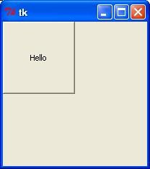
Pack Geometry Manager (2/2)
Simplest of the three geometry managers, do not use for ordinary windows as it is too much work. Instead use it for making more complex containers.
Place is available for all widgetsfrom tkinter import *
import tkinter as tk
top = tk.Tk()
def helloCallBack():
tk.tkMessageBox.showinfo( "Hello Python", "Hello World")
B = tk.Button(top, text ="Hello", command = helloCallBack)
B.pack()
B.place(bordermode=OUTSIDE, height=100, width=100)
top.mainloop()

Slide 35
More Widgets ENTRY , CHECKBUTTONS, RADIO BUTTONS, SCALE

Slide 36
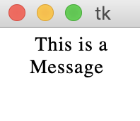
Message
The Message widget is used to display text. This is a widget not a text window. Use for on screen instructions or to make a custom message window
from tkinter import *
master =Tk()
msg = Message(master, text=' This is a Message')
msg.config(font=('times',14))
msg.pack()
mainloop()
options: anchor aspect
background/bg
padx pady relief
borderwidth/bd cursor
font foreground/fg
highlightbackground highlightcolor highlightthickness justify
takefocus text textvariable width

Slide 37


Entry (1/2)
Used to enter or display a single line of text
To enter multiple lines of text, use the Text widget.
from tkinter import * master = Tk()
e = Entry(master) e.pack() mainloop()
methods:
options: anchor aspect
background/bg borderwidth/bd cursor
font foreground/fg
get()
set()
delete(first,last/END)
relief takefocus text textvariable width
insert(index)
insert(index,string)
icursor(index)
index(index)
highlightbackground highlightcolor highlightthickness
validate validatecommand justify

Slide 38
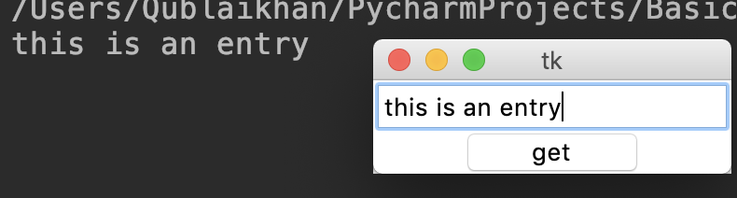
Entry (2/2)
from tkinter import *
master = Tk()
e = Entry(master) e.pack()
def callback(): print (e.get())
b = Button(master, text="get", width=10, command=callback) b.pack()
mainloop()

Slide 39
Frame Widget
Frames are used as containers for other widgets. Widgets placed in a frame can use any of the geometry managers (but only one per frame)
You can have multiple frames per window
Options:
bg | background color
bd | border width (default=2 pixels)
cursor | cursor to use when hovering over the frame
height | vertical dimension of the frame
highlightbackground | color when frame doesn’t have focus
highlightcolor | color when frame has focus
highlightthickness | thickness of the focus highlight
relief | FLAT, Raised, Sunken, GROOVE, RIDGE; default = FLAT
width | Width of the frame

Slide 40
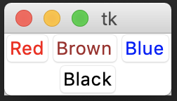
Frame Example
from tkinter import * root = Tk()
frame = Frame(root) frame.pack()
bottomframe = Frame(root) bottomframe.pack( side = BOTTOM )
redbutton = Button(frame, text="Red", fg="red") redbutton.pack( side = LEFT)
greenbutton = Button(frame, text="Brown", fg="brown") greenbutton.pack( side = LEFT )
bluebutton = Button(frame, text="Blue", fg="blue") bluebutton.pack( side = LEFT )
blackbutton = Button(bottomframe, text="Black", fg="black") blackbutton.pack( side = BOTTOM)
root.mainloop()

Slide 41
Checkbuttons and Radiobuttons
Checkbuttons are used for multiple choice situations, i.e. choosing m of n possible options. This is done by assigning each checkbox a variable of its own.
Radiobuttions are used for choosing one of n possible choices; i.e. a mutually exclusive single choice by giving each button a unique value of the same Tkinter variable.

Slide 42
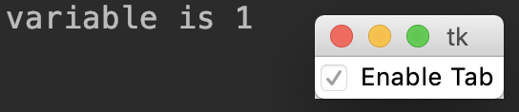
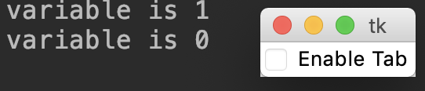
Checkbutton (1/2)
from tkinter import *
def cb():
print ("variable is", var.get())
win = Tk() var = IntVar()
c = Checkbutton(
win, text="Enable Tab", variable=var,
command= (lambda: cb())) c.pack()
mainloop()

Slide 43
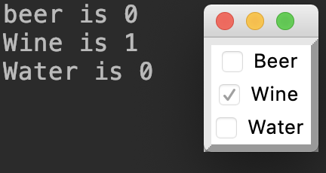
Checkbutton (2/2)
from tkinter import *
def cb():
print("beer is", var1.get()) print("Wine is",var2.get()) print("Water is", var3.get())
win = Tk()
f = Frame(relief=RAISED , borderwidth=5) var1 = IntVar()
var2 = IntVar() var3 = IntVar()
c1 = Checkbutton( f, text="Beer", variable=var1,
command= (lambda: cb())) c1.pack(side=TOP)
c2 = Checkbutton( f, text="Wine", variable=var2,
command= (lambda: cb())) c2.pack(side=TOP)
c3 = Checkbutton( f, text="Water", variable=var3,
command= (lambda: cb())) c3.pack(side=TOP)
f.pack()
mainloop()

Slide 44
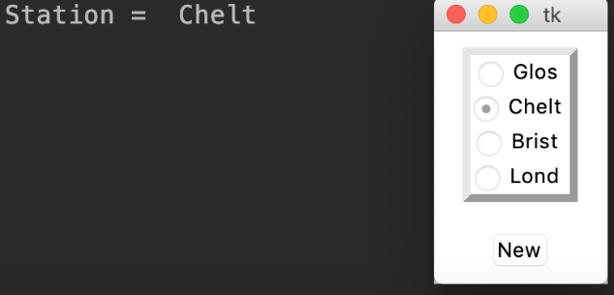
Radiobuttons (1/2)
from tkinter import *
def change():
print ('Station = ' , var.get())
root = Tk()
stations = ‘Glos' , ‘Chelt' , ‘Brist' , ‘Lond'
f = Frame(relief=RAISED , borderwidth=5) var = StringVar()
for station in stations:
radio = Radiobutton(f, text=station, variable=var ,value=station) radio.pack(side=TOP)
f.pack(pady=10)
Button(root,text='New' , command=(lambda: change())).pack(pady=10) var.set(‘GLOS') #initalize the set of radio buttons
mainloop()

Slide 45
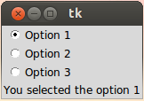
Radiobuttons (2/2)
from tkinter import *
def sel():
selection = "You selected the option " + str(var.get()) label.config(text = selection)
root = Tk() var = IntVar()
R1 = Radiobutton(root, text="Option 1", variable=var, value=1, command=sel) R1.pack( anchor = W )
R2 = Radiobutton(root, text="Option 2", variable=var, value=2, command=sel) R2.pack( anchor = W )
R3 = Radiobutton(root, text="Option 3", variable=var, value=3, command=sel) R3.pack( anchor = W)
label = Label(root) label.pack() root.mainloop()

Slide 46
Sliders
A slider is a Tkinter object with which a user can set a value by moving an indicator. Sliders can be vertically or horizontally arranged. A slider is created with the Scale method().
Using the Scale widget creates a graphical object, which allows the user to select a numerical value by moving a knob along a scale of a range of values. The minimum and maximum values can be set as parameters, as well as the resolution. We can also determine if we want the slider vertically or horizontally positioned. A Scale widget is a good alternative to an Entry widget, if the user is supposed to put in a number from a finite range, i.e. a bounded numerical value.

Slide 47
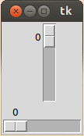
Slider: A Simple Example
from tkinter import *
master = Tk()
w = Scale(master, from_=0, to=42) w.pack()
w = Scale(master, from_=0, to=200, orient=HORIZONTAL) w.pack()
mainloop()

Slide 48
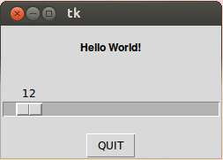
Label, Button, and Scale Demonstration
from tkinter import * def resize(ev=None):
label.config(font='Helvetica -%d bold' % scale.get()) top = Tk()
top.geometry('250x150')
label = Label(top, text='Hello World!', font='Helvetica -12 bold')
label.pack(fill=Y, expand=1)
scale = Scale(top, from_=10, to=40, orient=HORIZONTAL, command=resize)
scale.set(12) scale.pack(fill=X, expand=1)
quit = Button(top, text='QUIT', command=top.quit, activeforeground='white', activebackground='red')
quit.pack() mainloop()

Slide 49
Next Session!
SQLite Database in Python (sqlite3)
Link GUI to SQLite Database

